Slide 1
Analysis of Algorithms
Lecture 3

Slide 2
Selection Sort

Slide 3
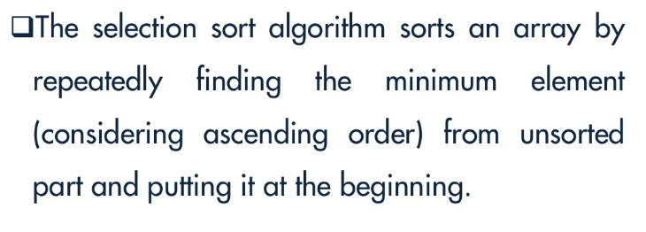
Selection Sort

Slide 4
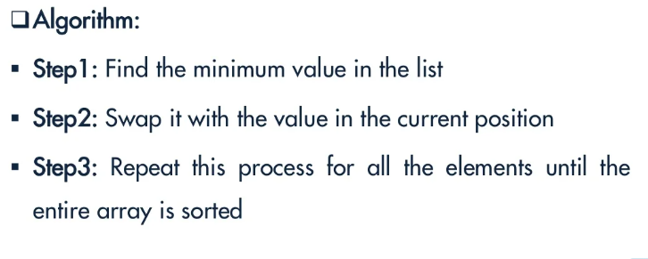
Selection Sort

Slide 5
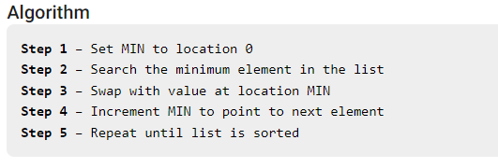
Selection Sort

Slide 6
Selection Sort
Find the smallest card. Swap it with the first card.
Find the second-smallest card. Swap it with the second card.
Find the third-smallest card. Swap it with the third card.
Repeat finding the next-smallest card, and swapping it into the correct position until the array is sorted.

Slide 7
Selection Sort
The algorithm maintains two subarrays in a given array.
The subarray which already sorted.
The remaining subarray was unsorted.

Slide 8
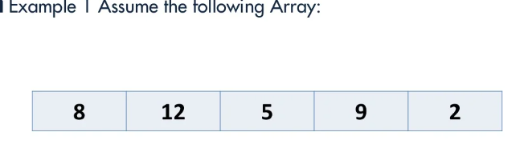
Selection Sort

Slide 9
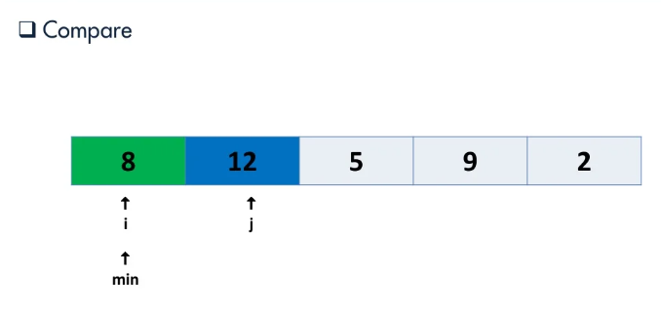
Selection Sort

Slide 10
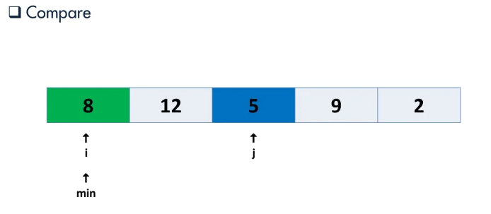
Selection Sort

Slide 11
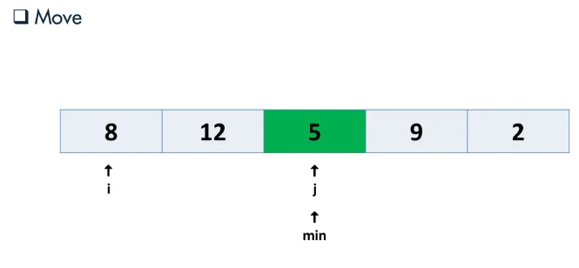
Selection Sort

Slide 12
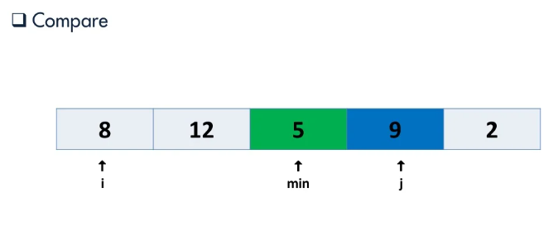
Selection Sort

Slide 13
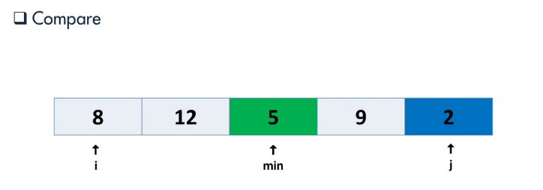
Selection Sort

Slide 14
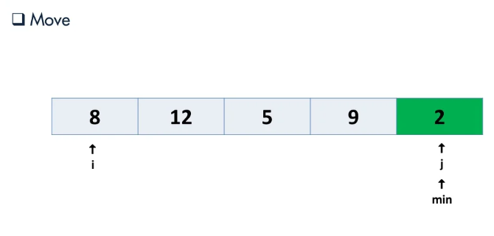
Selection Sort

Slide 15
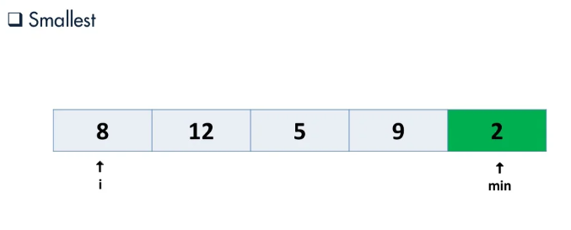
Selection Sort

Slide 16
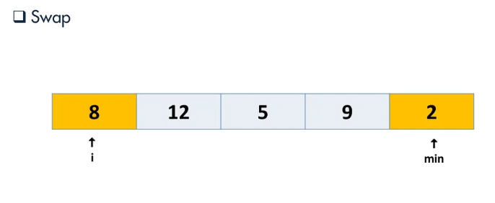
Selection Sort

Slide 17
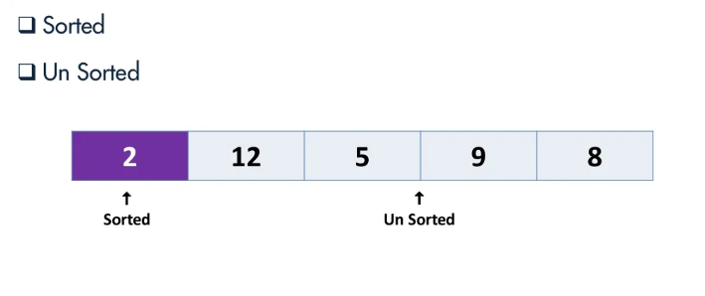
Selection Sort

Slide 18
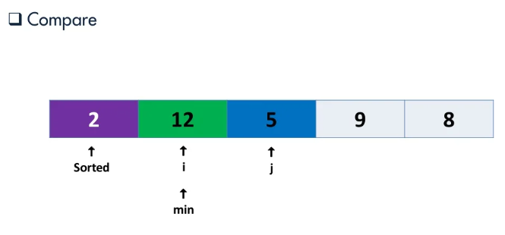
Selection Sort

Slide 19
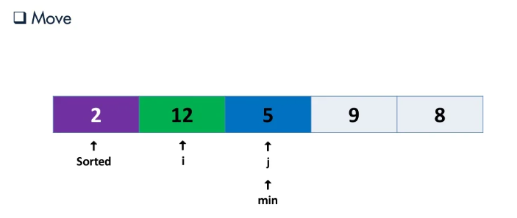
Selection Sort

Slide 20
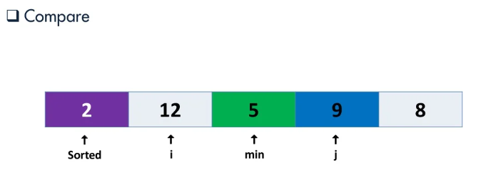
Selection Sort

Slide 21
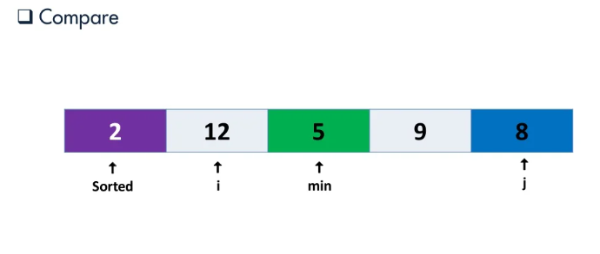
Selection Sort

Slide 22
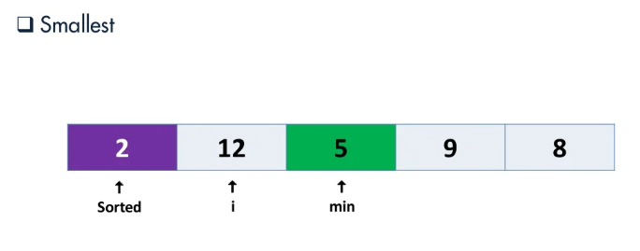
Selection Sort

Slide 23
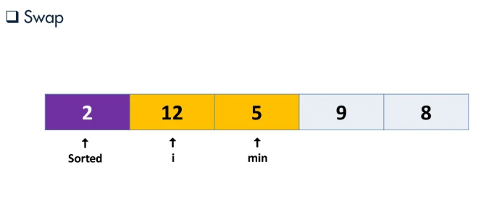
Selection Sort

Slide 24
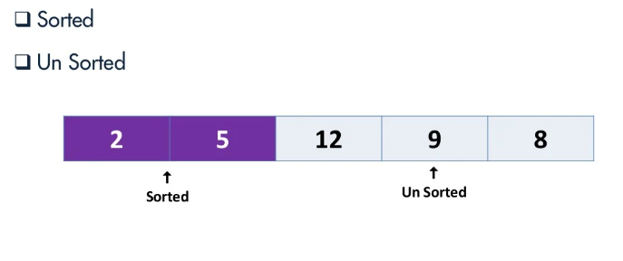
Selection Sort

Slide 25
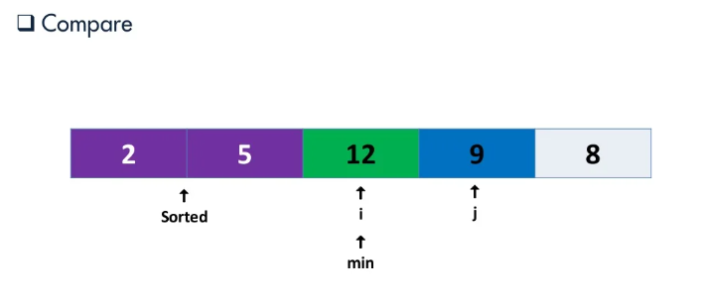
Selection Sort

Slide 26
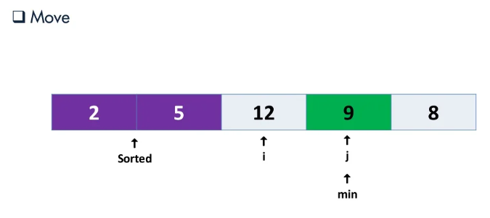
Selection Sort

Slide 27
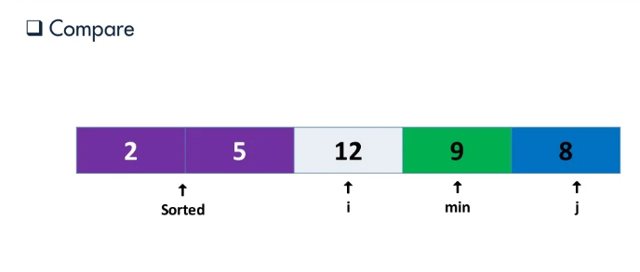
Selection Sort

Slide 28
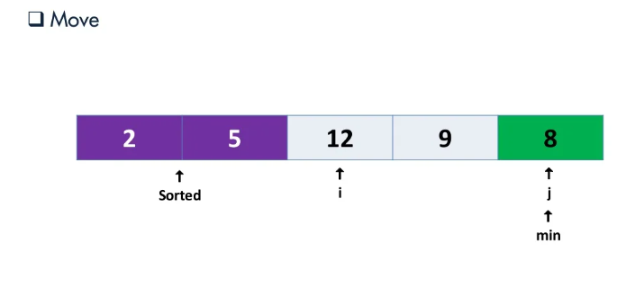
Selection Sort

Slide 29
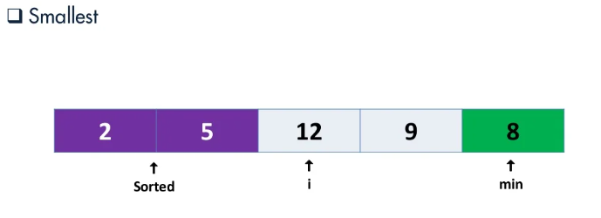
Selection Sort

Slide 30
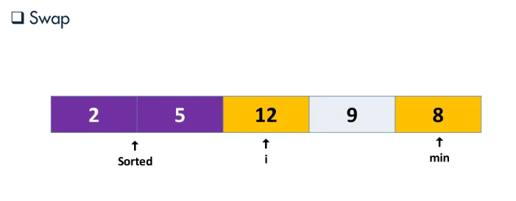
Selection Sort

Slide 31
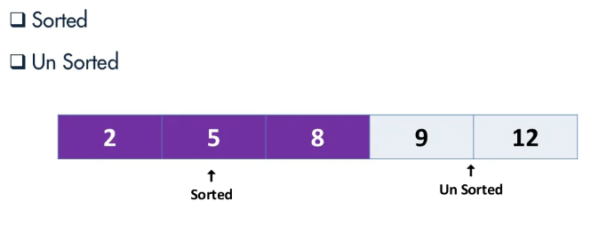
Selection Sort

Slide 32
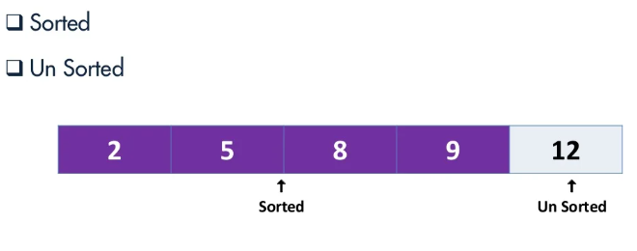
Selection Sort

Slide 33
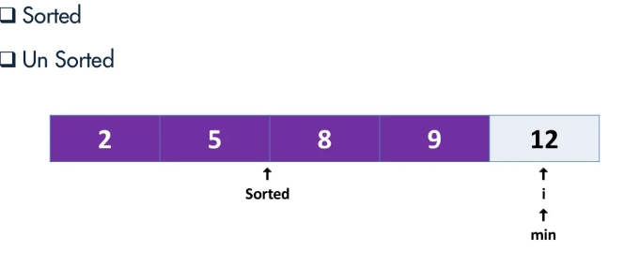
Selection Sort

Slide 34
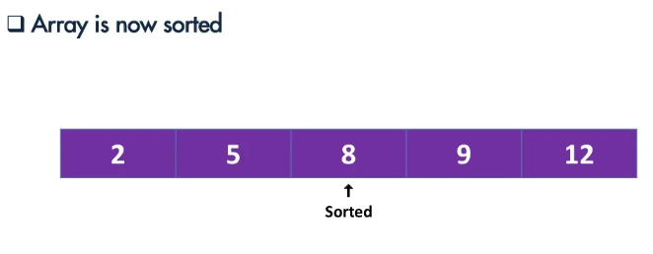
Selection Sort

Slide 35
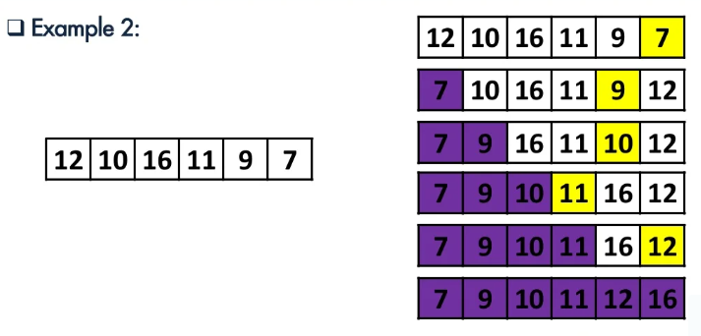
Selection Sort

Slide 36
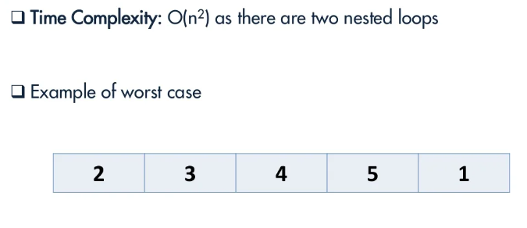
Time Complexity

Slide 37
Time Complexity
The time complexity of Selection Sort is O(N²) as there are two nested loops:
One loop to select an element of Array one by one = O(N)
Another loop to compare that element with every other Array element = O(N)
It has O(n²) time complexity.
O(n²) isn’t a good time complexity for sorting lists when it comes to large input sizes.

Slide 38
Insertion Sort

Slide 39
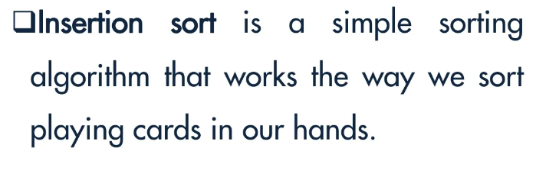
Insertion Sort

Slide 40
Characteristics of Insertion Sort
This algorithm is one of the simplest algorithm with simple implementation
Basically, Insertion sort is efficient for small data values
Insertion sort is adaptive in nature, i.e. it is appropriate for data sets which are already partially sorted.

Slide 41
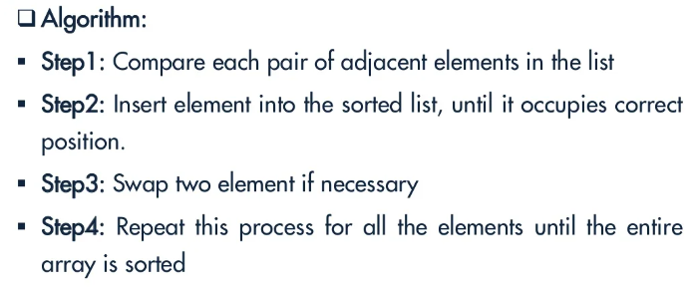
Insertion Sort

Slide 42
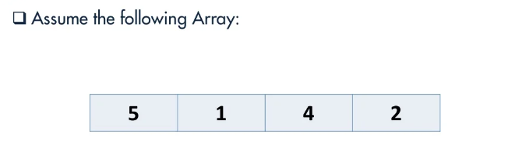
Example

Slide 43
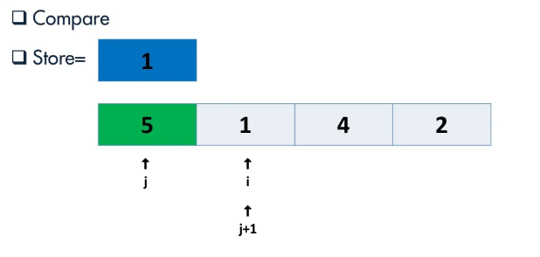

Slide 44
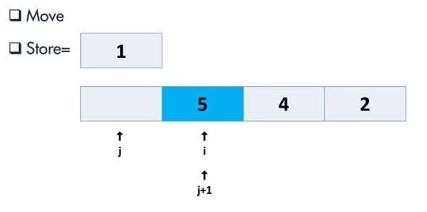

Slide 45
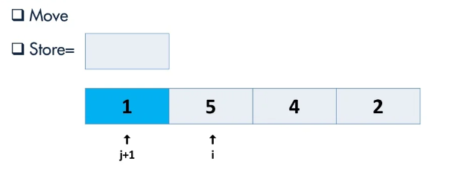

Slide 46
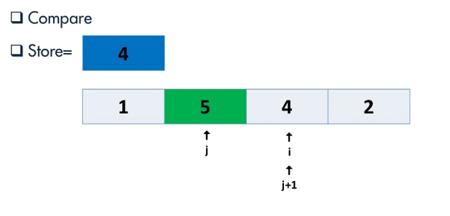

Slide 47
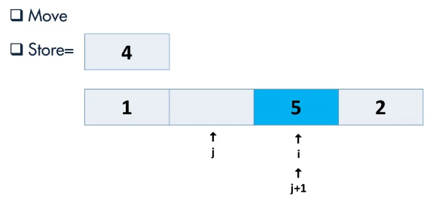

Slide 48
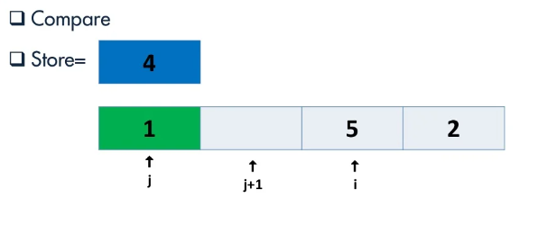

Slide 49
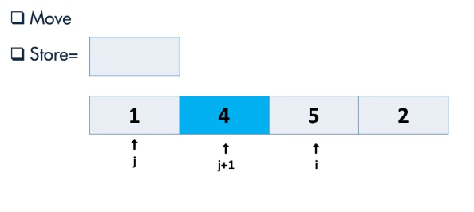

Slide 50
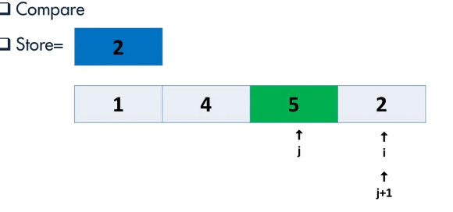

Slide 51
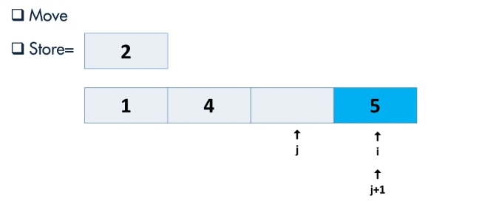

Slide 52
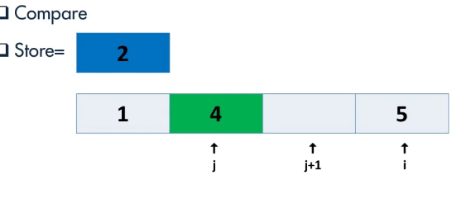

Slide 53
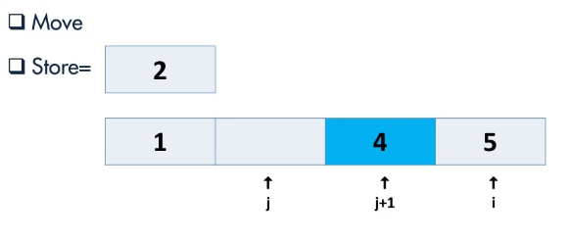

Slide 54
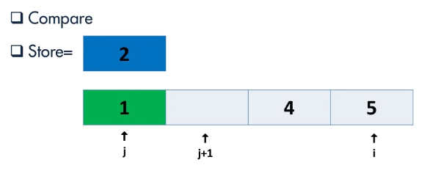

Slide 55
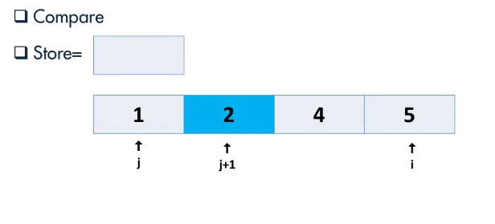

Slide 56
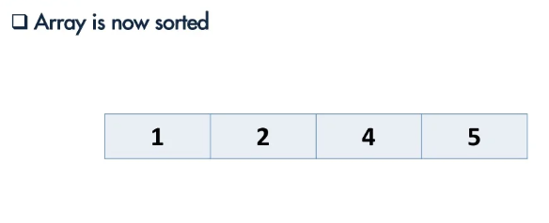

Slide 57
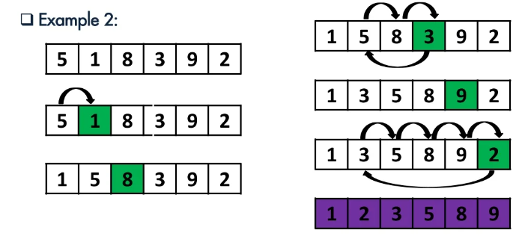
Example 2

Slide 58


Slide 59


Slide 60


Slide 61

Example 2

Slide 62


Slide 63


Slide 64


Slide 65


Slide 66


